Slide 1
How to
Capstone
Matz Duebbert
Lab&Tech Services Manager
11/08/2026
(1) Meet your Lab&Tech Support,
(2) Budgeting & Finance and
(3) eMarket & Procurement Steps
(4) The Creator Space (TCS)
Semester 2, 2026

Slide 2
(1) Meet your Lab&Tech Support,
(2) Budgeting & Finance and
(3) eMarket & Procurement Steps
Semester 1, 2026

Slide 3
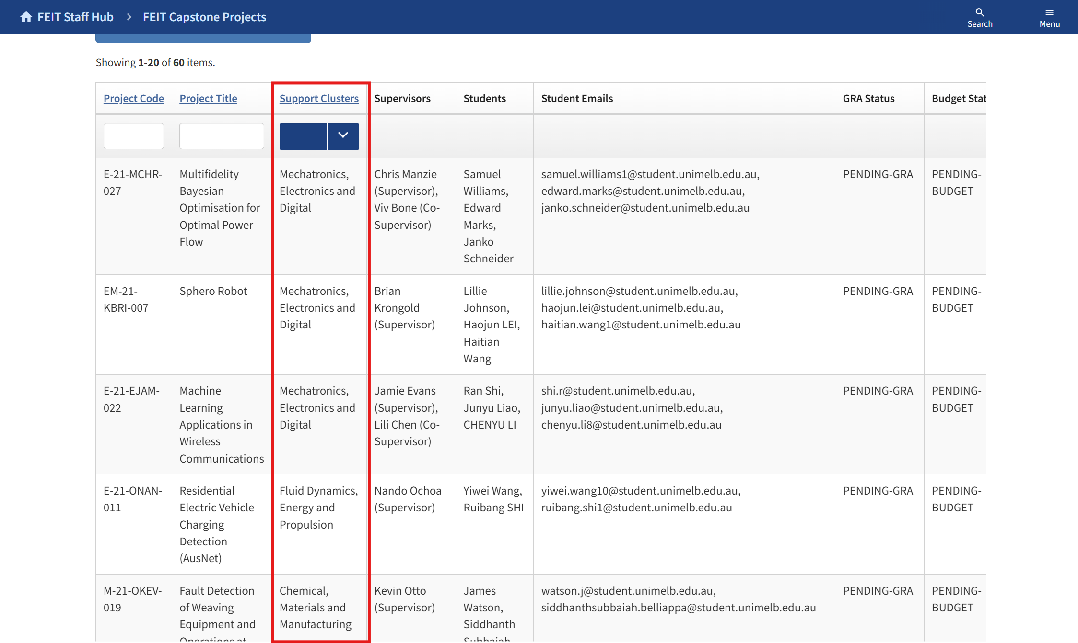
Who is supporting your project?
- Log in to FEIT Capstone App Website locate the name and email of your Lab&Tech Cluster

Slide 4
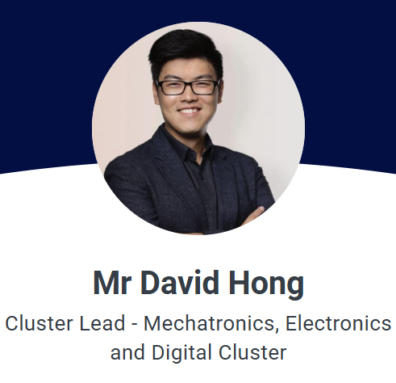

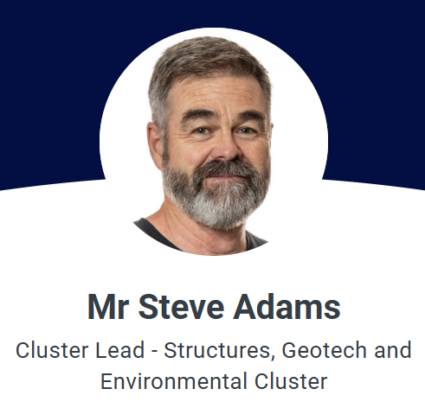
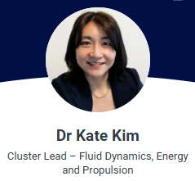
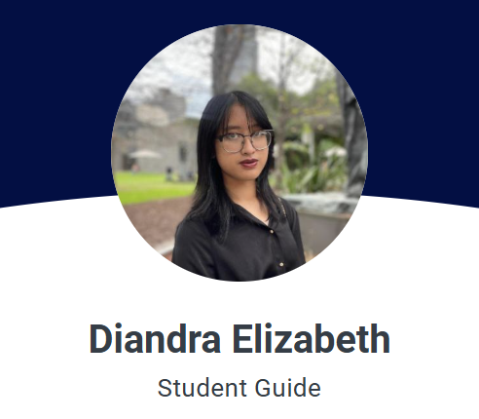
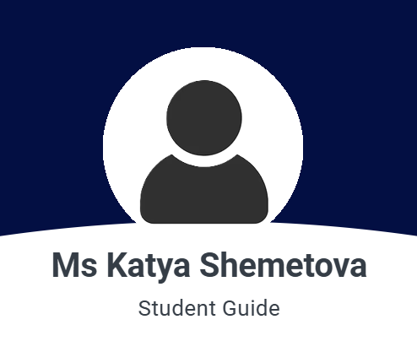
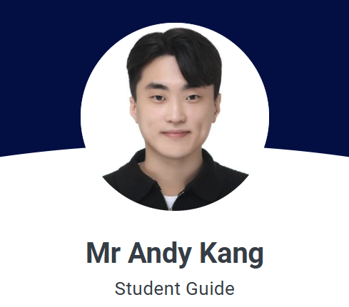
Meet your support
Lab&Tech Support
Student Guides

Slide 5
Emails you should know:
The Lab&Tech Clusters:
Chemical, Materials and Manufacturing: feit-cmmlabcluster@unimelb.edu.au
Fluid Dynamics, Energy & Propulsion: feit-fdeplabcluster@unimelb.edu.au
Mechatronics, Electronics & Digital: feit-MEDlabcluster@unimelb.edu.au
Structures, Geotech & Environmental: feit-SGElabcluster@unimelb.edu.au
Biomedical and Bioengineering: feit-bblabcluster@unimelb.edu.au
The FEIT Student Guides: feit-studentguide@unimelb.edu.au
Tip – please include your capstone group name in the subject of all emails (eg EMI-21-MMIC-042).

Slide 6
Organise a meeting with your Lab&Tech Cluster
Things to discuss with your Lab&Tech Cluster:
      Risk Assessment – the Lab&Tech Cluster will be one of your subject matter experts (SMEs) and can help you define your risks and assist with developing appropriate controls.
      Please come with a draft risk assessment and ensure you have completed your LMS safety training.
      Training – based on the risks in your project the Lab&Tech Cluster may allocate additional safety training to you, for example Chemical
      Management training. This will be made available via TrainMe.
      Lab Access – if you need to work in a lab your Lab&Tech Cluster will help arrange the appropriate Local Area Induction, any bench
      allocation if required and any additional training to access speciality equipment.
      Specialty Equipment and or Services – If you require access to specialty expert services (e.g. Engineering Workshop) and/or specialty
      equipment, your Lab&Tech Cluster will advise how to access these (e.g. sign up to iLab etc.).
      The Creator Space – TCS is free for everyone to use between the hours of 10am and 7pm.
      If you have yet to attend Induction training, please start here: https://eng.unimelb.edu.au/the-creator-space
      Materials and expenses – if you will have to procure consumables, IT equipment, software, access to Ai, PPE, have travel expenses, other
      equipment needs your Lab&Tech Cluster can advise if these are readily available/”in-kind” or how to procure them.

Slide 7
(1) Meet your Lab&Tech Support,
(2) Budgeting & Finance and
(3) eMarket & Procurement Steps
Semester 1, 2026

Slide 8
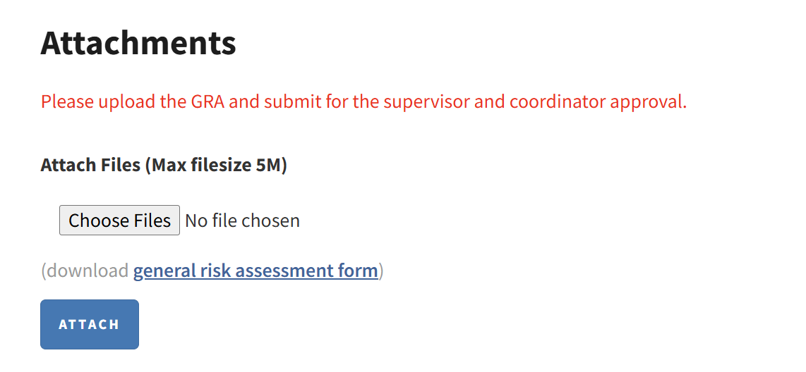

Submit your General Risk Assessment (GRA)
Open from 21.08.
The GRA is required to get to the budget stage of your project.
All safety documentation should be written with your supervisor and reviewed by the Lab&Tech Cluster (as well as any other relevant SMEs) prior to submitting.
You might be required to prepare additional safety documentation beyond the GRA that is mandatory for each project – this will depend on the activities you will undertake.
Other safety documentation could be:
      Task Risk Assessments (tRAs)
      Chemical Risk Assessments (cRAs)
      Standard Operational Procedures (SOPs)
      Plant Risk Assessments (pRAs)
All safety documentation should be regularly
Revisited, Reviewed and Revised.

Slide 9
Consider your anticipated expenses (1/2)
Budget open from 04.09.
(IT) Equipment – if you think you need hard drives, a Wi-Fi router, speciality cameras etc?
Check in with the Lab&Tech Cluster - these are typically lent to Capstone Teams for the duration of their project and recovered
for re-issue. These need to be declared as “in-kind” in the Capstone Budget.
Software & Ai – the university has a range of software as well as GenAi subscriptions readily available – on the flipside there are also restrictions on what software get
permission to be purchased.
Let your Lab&Tech Cluster know and they will work with the central IT team to determine the best way to procure.
‘Free’ software & GenAi subscriptions should be included as “in-kind” in the Capstone Budget.
Travel – travel costs can be covered under certain circumstances (e.g. if your project requires regular visits to the Industry partner or your project requires field work
sample collection).
Check in with your Lab&Tech Cluster to see if you qualify for travel expenses.
Travel expenses will only be covered where the location is more than 35km from Parkville.
Electronics – these must be purchased; The Creator Space (TCS) consumables cannot be used for capstone projects/”in-kind”.
Suppliers that are readily available in eMarket include – Core, RS Components, Altronics, Element 14, Jaycar.
Printed Circuit Boards (PCBs) can be ordered via PCBWay - your Lab Cluster will assist.
Lithium Batteries & Power Supplies - projects involving lithium batteries or AC-powered equipment are subject to additional safety and compliance
requirements. Failure to meet these requirements may restrict laboratory access, testing activities etc.
Nuts, bolts, screws, nails, acrylic, wood etc. - these must be purchased; TCS consumables cannot be used for capstone projects/”in-kind”.
Suppliers that are readily available in eMarket include – Bunnings, Dean Distributors

Slide 10
Consider your anticipated expenses (2/2)
Sheet metal, other structural metals – check with your Lab Cluster or FEIT Workshop.
Chemicals – check with your Lab&Tech Cluster, many chemicals are readily available in the lab and due to restrictions on storage and the hazardous nature of chemicals it’s
preferred to use existing. Some chemicals are available via the University Specialist Store, check with your Lab&Tech Cluster regards preferred suppliers.
PPE – lab coats, masks and glasses are generally available in the lab you will be working in.
Everyone who attends a TCS Induction session will receive a pair of safety glasses. Please keep these for future use.
If you think you require speciality PPE please talk to you Lab&Tech Cluster.
Where a lab or a task or your industry sponsor mandate safety shoes the Faculty will fund up to $39.00 per student.
3D Printing – PLA (Polylactic acid) 3D printing is available from TCS free of charge. You can reach out to TCS to discuss your 3D printing needs.
Specialty material may need to be outsourced and the costs for this will need to be covered by your budget.
Speciality items – anything not available from an eMarket supplier? Check in with the Lab&Tech Cluster. Often, we can find an eMarket supplier who can special order.
Prepayment required – does your preferred supplier require upfront payment? Check in with the Lab&Tech Cluster.
Items and suppliers must be compliant with Australian laws and the suppliers reputable.
Make sure to check!

Slide 11
Why can’t I just buy the good myself and claim reimbursement?
Your goods need to be reviewed prior to purchase. The Uni takes safety seriously and this includes insuring goods are safe and suitable for the Australian market.
This might be true but by buying cheap goods you might be contributing to Moden Slavery (https://humanrights.gov.au/modern-slavery) and the University has made a commitment to help stamp this out. All University suppliers must confirm they comply to the Modern Slavery Act 2018 (https://www.legislation.gov.au/C2018A00153/latest/text).
Additionally, the items might not meet Australian standards in safety and compliance.
There will be no reimbursements for purchases that you have done yourself.
But it’s cheaper to buy on ebay, Alibaba, Temu, etc.
All suppliers on eMarket have been pre-vetted and
their goods (generally) meet the standards.

Slide 12
(1) Meet your Lab&Tech Support,
(2) Budgeting & Finance and
(3) eMarket & Procurement Steps
Semester 1, 2026

Slide 13
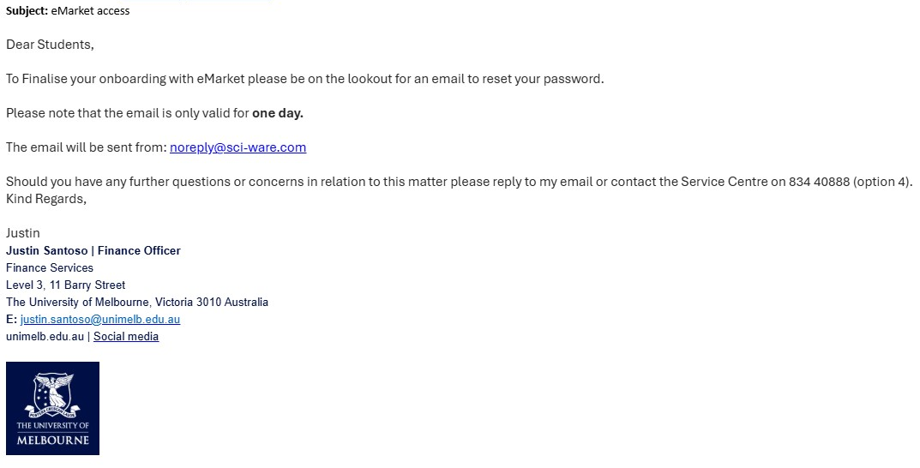
Step 1: Reset your eMarket Password
Everyone will received two emails.
  1. from a Finance Officer, subject:
  eMarket access
  2. from noreply@sci-ware.com
  with your reset password link.
      (Expires in 24 hours)
For issues with access, please reply to the email from the Finance Officer (Finance Services).

Slide 14
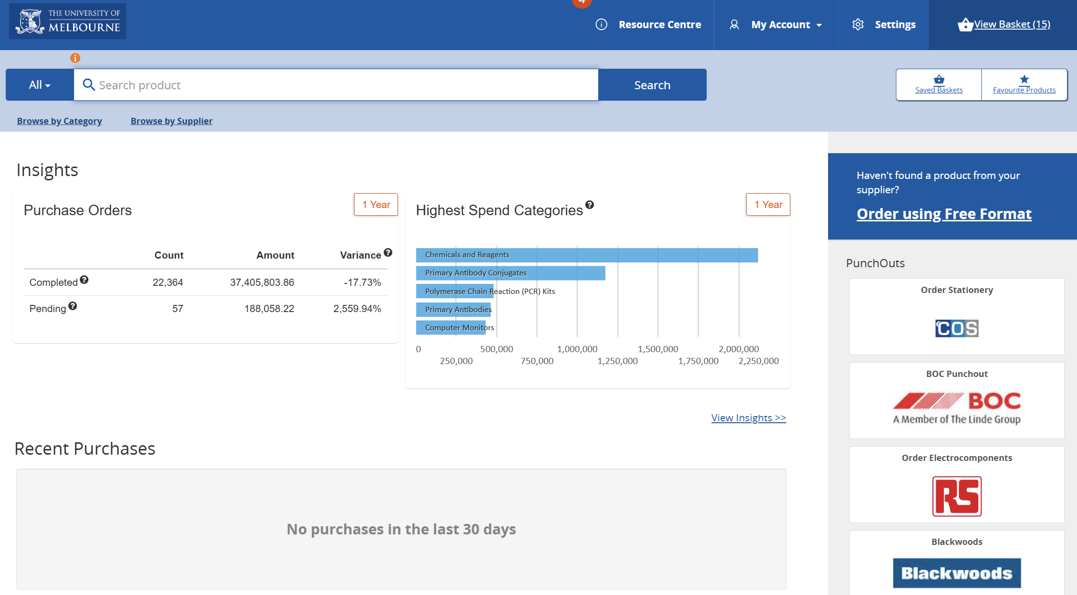
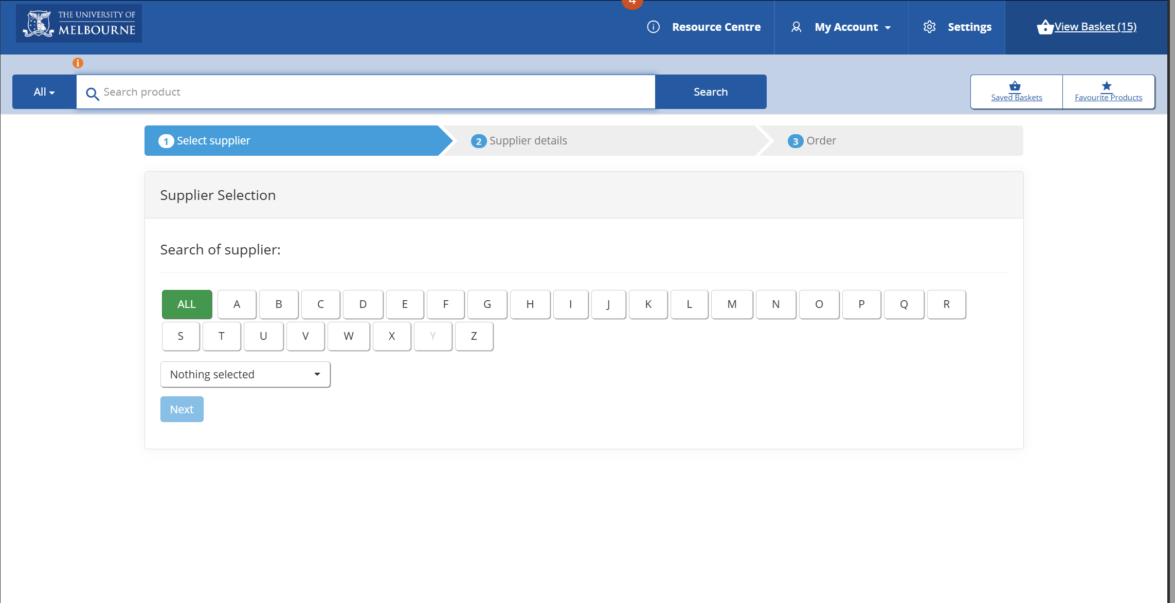
Step 2: Login to eMarket
URL: https://aus.sci-ware-customer.com/sword/login.do#iso/AUS
UserID: Your student email
All suppliers on eMarket have been pre-vetted and their items meet the standards.

Slide 15
Step 3: Start your basket(s)
Log onto eMarket and start a basket, remember you can use multiple
suppliers for the 1 basket.
If the items are not on eMarket please reach out to your Lab Cluster and the FEIT Student Guide Team.
Tip One – If an item is cheaper from an alternative supplier consider the delivery charges (saving $5 on an item but spending an extra $10 on
delivery is not saving) or possible time impacts.
Tip Two – you can raise/prepare multiple baskets, if you need some items now and some items later you can just order what you need now.
Tip Three – remember to contact the supplier for stock levels, we aren’t resourced do this for you.
Tip Four – please use your capstone group name for your basket (eg EMI-21-MMIC-042).
Tip Five – please ‘share’ your basket with the lab cluster team member you have been working with AND the FEIT Student Guides:
Diandra Elizabeth, Mr Andy Kang, Ms Katya Shemetova
→ Please remember to tick the box “user can change…”
Tip Six – if all else fails read the user guide!

Slide 16
Step 4: The team will place your order
You will be sent confirmation of the Purchase Order and/or any upfront payment.
Step 5: Deliveries
You will be advised at the time of ordering how your materials will be delivered:
  Collect from store – some suppliers are happy for you to collect in store.
  We will advise you at the time with specific instructions regarding
  how to collect from which store.
  Hazardous/bulky items – these will be delivered to one of the Uni speciality stores.
  We will advise you on collection processes at time of ordering.
  FEIT Loans Hub – most items are delivered by the Uni mail team to the FEIT Loans Hub.
  They will be placed in a locker for you collect.
  We have limited lockers so we ask if you can collect with ~48hrs.
You will be contacted as soon as your items arrive.
Please feel free to reach out directly to the supplier for stock levels and delivery queries.

Slide 17
Step 6: Returns
If you have lent any device or have an item that can be re-used, your lab cluster will reach out prior to Endeavour to discuss returns.

Slide 18
The Creator Space (TCS)
Semester 1, 2026

Slide 19
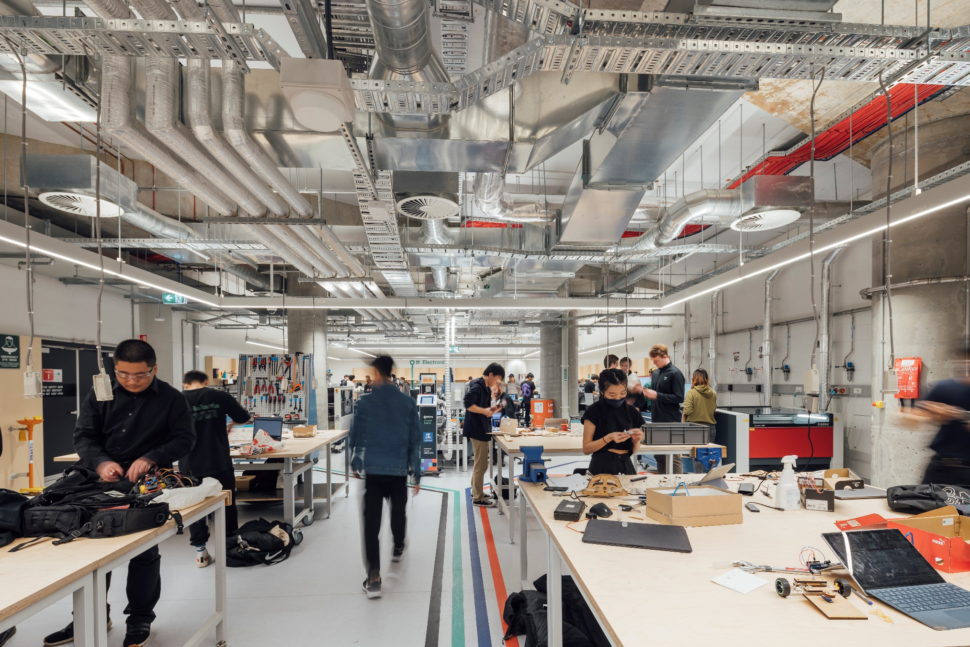

eng.unimelb.edu.au/telstra-creator-space#start-making
TCS - Overview
Open Monday to Friday 10-7pm
Extensive range of tools and equipment from
laser cutting, Wood Shop, Metal Shop to electronics
Online and face to face training on the tools and equipment
Mandatory completion of General Maker training required to use space
Talented team with industry experience that provide a safe and supporting hands-on work environment
Start making….

Slide 20

TCS – Important to know
TCS cannot provide “in-kind” materials
Make sure materials you want to bring in are approved at concierge desk
You might be asked to provide your safety documentation
Some items that are not permitted in the space:
  240V equipment
  Lithium batteries
  Fibreglass
  Carbon fibre
  Marine plywood
Plan ahead! TCS can be very busy!

Slide 21
If you are wondering about it,
someone else probably does too.
What questions do you have?

